Slide 1
SCM and logistics – Session 2
To day: Intro to Business and semester
SCM
Logistics

Slide 2
Learning points SCM and logistics
After this session you should be able to explain key concepts in relation to Supply Chain Management (SCM).
Key concepts in SCM
What is SCM
Explain the SCM concept to a fellow student
Describe the information flowing in the SCM
Key concepts in Logistics
What is logistics?
Explain the logistics concept to a fellow student

Slide 3
Supply Chain Management
Session 1

Slide 4
What is SCM?
Supply Chain Management (SCM) is the coordination/management of all supply activities (production, services, information etc.) of an organisation from its suppliers and partners to its customers.

Slide 5
SCM activities
Upstream supply chain
Activities which are related to buy-side e-business
Downstream supply chain
Activities which are related to sell-side e-business
Parts of SCM
Suppliers
Intermediaries (supplier’s supplier, customer’s customer)
Customers
Supply Chain Network
More accurate description

Slide 6
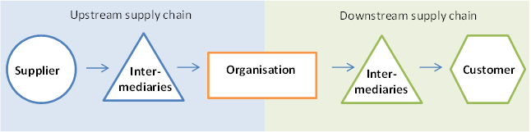
SCM activities

Slide 7
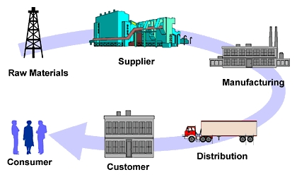
SCM activities

Slide 8
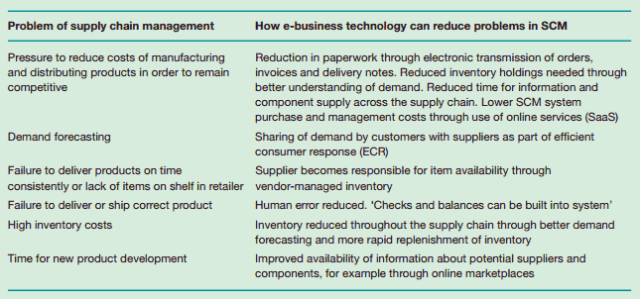
Why SCM?

Slide 9
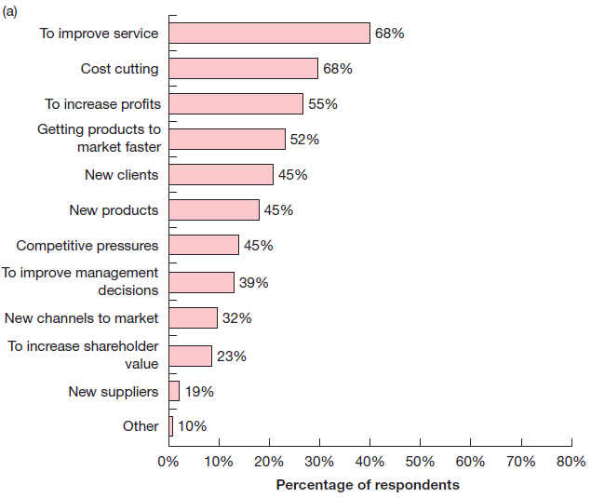
Reasons for SCM

Slide 10
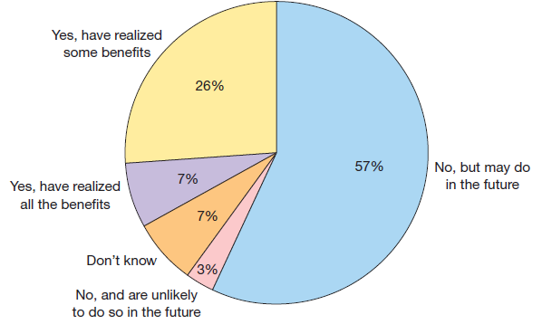
Realisation of SCM benefits

Slide 11
SCM example – BHP steel 1st phase
Objectives (1989 – 1993):
Using a PC based purchasing system to reduce data errors, reduce order time, reduce administration costs and improve management control
Results
Reduced number of suppliers to 12
80% of invoices placed electronically
7000 items eliminated from warehouse to be sourced directly from suppliers, on demand
Reduced lead time from 10 days to 26 hours

Slide 12
SCM example – BHP steel 2nd phase
Objectives (1990 – 1994):
Provide a combined upstream and downstream supply chain to benefit all parties
Results
Difficult to get customers involved – only 4 were involved after 4 years. They did not use the system as intended.
Why do you think it was hard to get customers involved?

Slide 13
SCM example – BHP steel 3rd phase
Objectives (1996 – 2010):
Move towards internet commerce
Improve e-communication from EDI to internet (making integration with suppliers and customers easier and cheaper)
Results
Main barriers is to convince third parties to implement the integration.

Slide 14
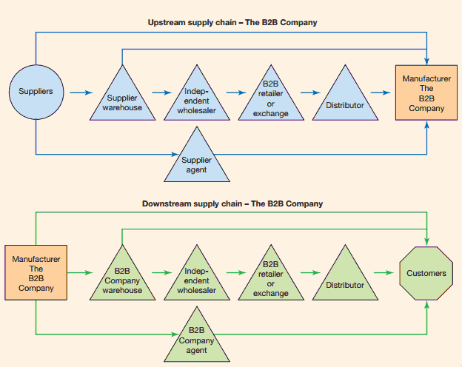
A simple SCM

Slide 15
A SCM exercise
Please create a supply chain for Vestbjerg Byggecenter A/S

Slide 16
Push/pull supply chain models
Push supply chain
A supply chain with distribution to passive consumers
Pull supply chain
Using the supply chain to deliver value to customers who are actively involved in product and service specification.
Consistent with Efficient consumer response (ECR)
ECR – creating and satisfying customer demand by optimizing product(s).
Change in supply chain thinking – Tendency of moving from push to pull (or combined)

Slide 17
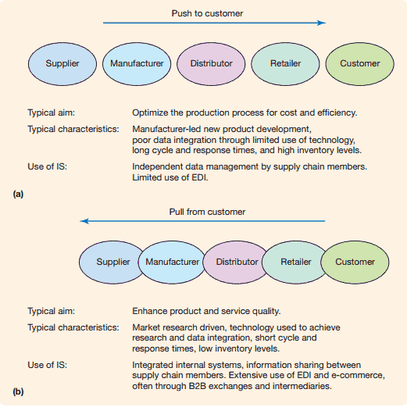
Push/pull supply chain models

Slide 18
The value chain
A model that considers how supply chain activities can add value to products and services delivered to the customer.
Within each element in the value chain
…also at the interface between the elements
Value = (benefit of each element - costs) + (benefit of each interface between elements - costs)

Slide 19
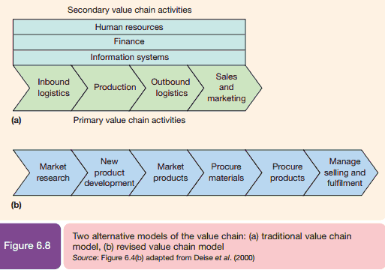

The value chain (Michael Porter)
Michael E. Porter
University Professor,
Harvard Business School

Slide 20
The value network
Takes both internal and external value chain into consideration
Some of the partners of a value network
Supply-side partners (upstream supply chain) such a suppliers, business-to-business exchanges, wholesalers and distributors
Partners that fulfil primary or core value chain activities e.g. outsourced inbound logistics
Sell-side partners (downstream supply chain) such as b2b exchanges, wholesalers and customers
Value chain integrators or partners who supply services that mediate the value chain – e.g. companies who supply IT infrastructure for a company

Slide 21
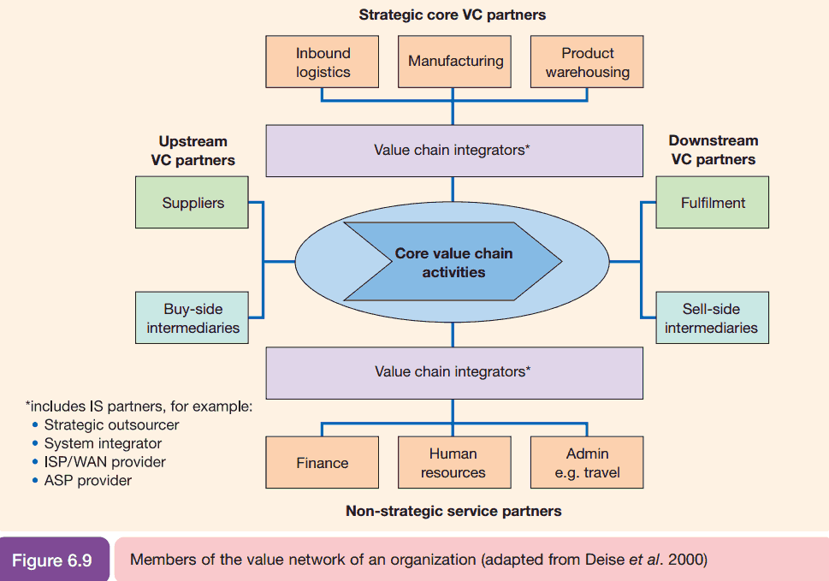
The value network

Slide 22
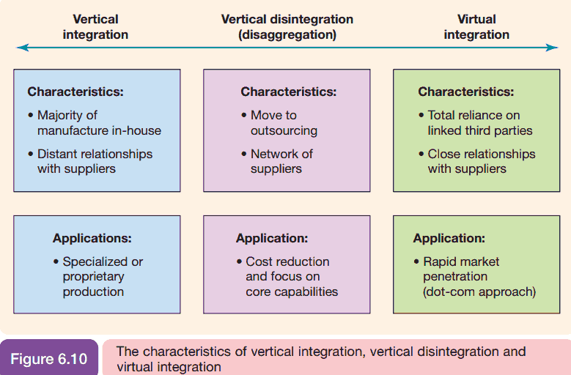
The value network – group exercise

Slide 23
The value network – group exercise
Please consider pros and cons in relation to the value network for a virtual organisation (virtual enterprise) compared to a non-virtual organisation
Please explain the following terms using figure 6.10
Vertical integration
vertical disintegration
virtual integration
Which type of organisation do you prefer (virtual/non-virtual)?

Slide 24
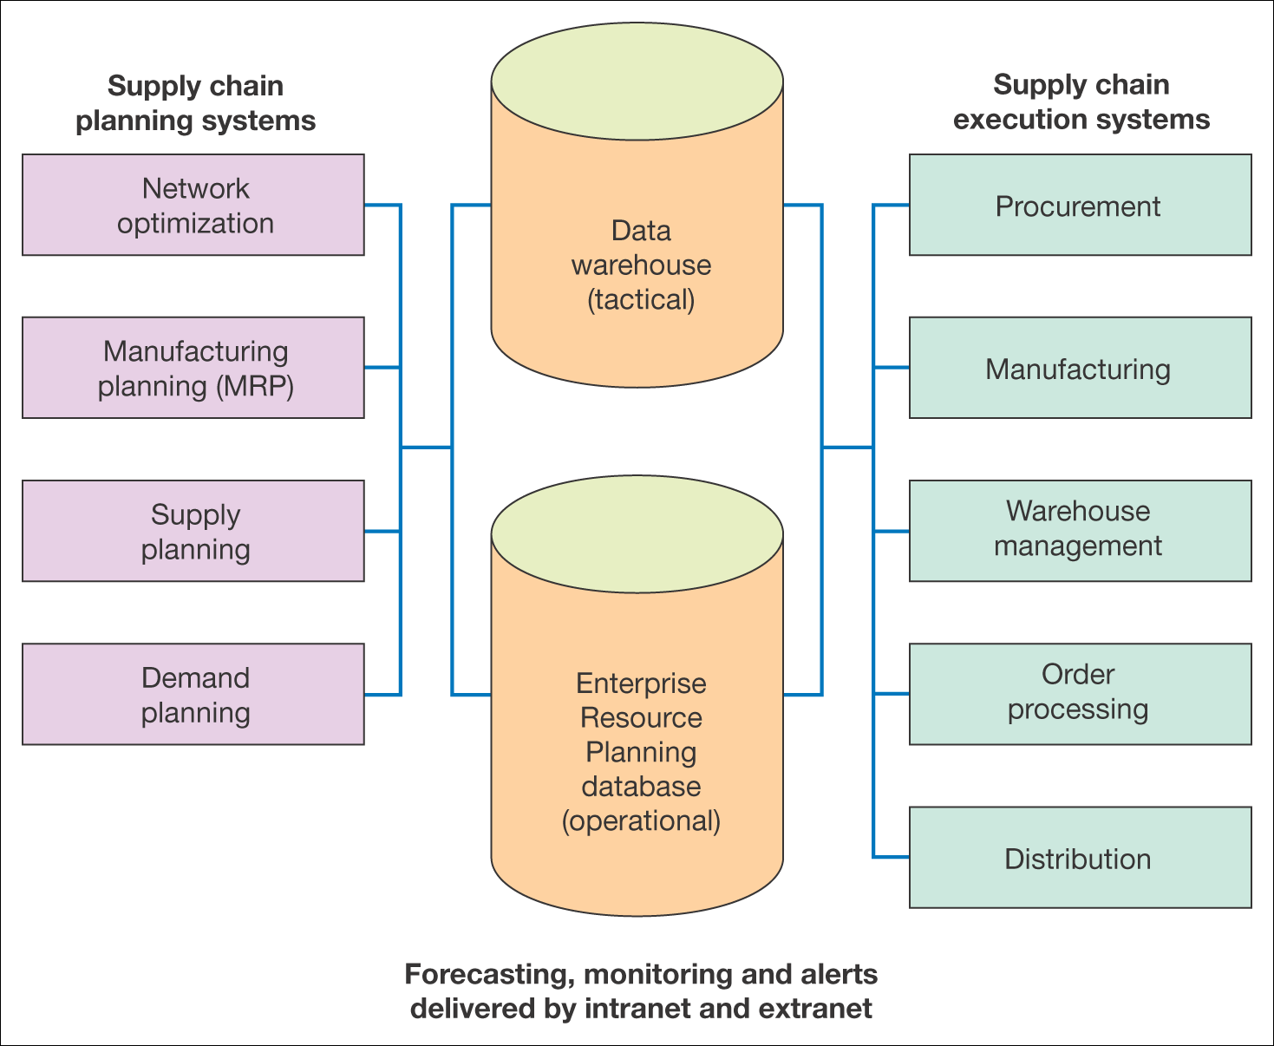
IS infrastructure for SCM

Slide 25
SCM – a real-life example using RFID*
A company was facing the following issues:
Problems keeping track of inventory
Failure to deliver products on time
Slow info flow (needed electronic transmission of info)
Human errors
* Radiofrekvens Identifikation

Slide 26
SCM – a real-life example using RFID
Case
A hospital needs to keep track of patients who have an appointment for examinations/operations to reduce waiting time (and optimizing work practices).
Guiding the patients finding their way around in the hospital using screens with RFID readers.
Radio-frequency identification (RFID)
SMS interface to text patients with last-minute changes

Slide 27
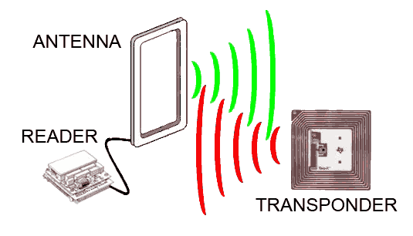
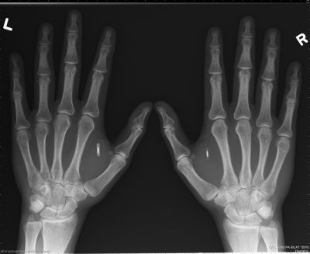
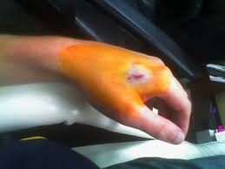
SCM – a real-life example using RFID

Slide 28
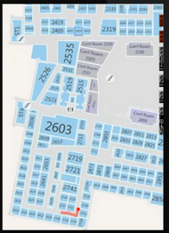

SCM – a real-life example using RFID

Slide 29
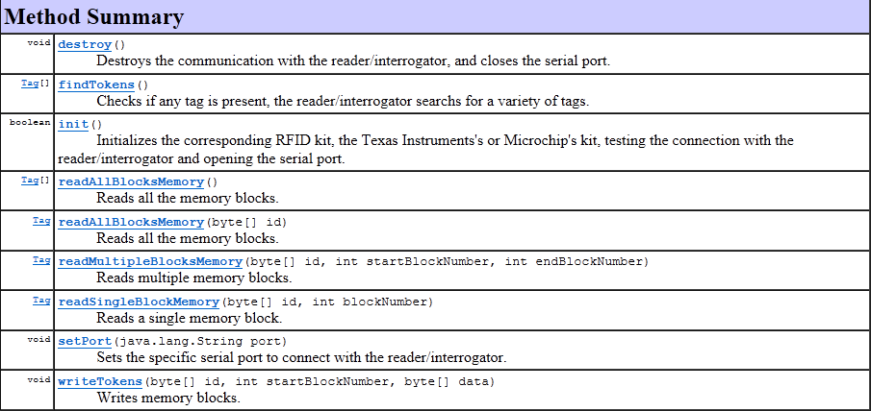
SCM – a real-life example using RFID

Slide 30
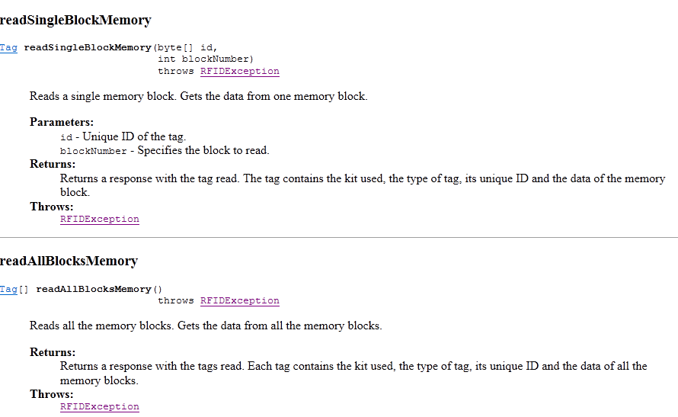
SCM – a real-life example using RFID

Slide 31
Group exercise – Case study 6.3
Please read case study 6.3 page 374 and answer the question

Slide 32
Logistics

Slide 33
Logistics intro and SCM finish
https://www.youtube.com/watch?v=Mi1QBxVjZAw
https://www.youtube.com/watch?v=-ZpHiMTwOdM

Slide 34
What is logistics?
Logistics is the time-related positioning of resource, or the strategic management of the total supply chain. The supply chain is a sequence of events intended to satisfy a customer. It can include procurement, manufacture, distribution, and waste disposal, together with associated transport, storage and information technology.
Logistics has to ensure an effective flow of raw materials, services and related information from the production of raw materials to consumption while taking customers’ needs into consideration

Slide 35
What is logistics?
Inbound logistics
The management of material resources entering an organisation from its suppliers and other partners
Outbound logistics
The management of resources supplied from an organisation to its customers and intermediaries

Slide 36
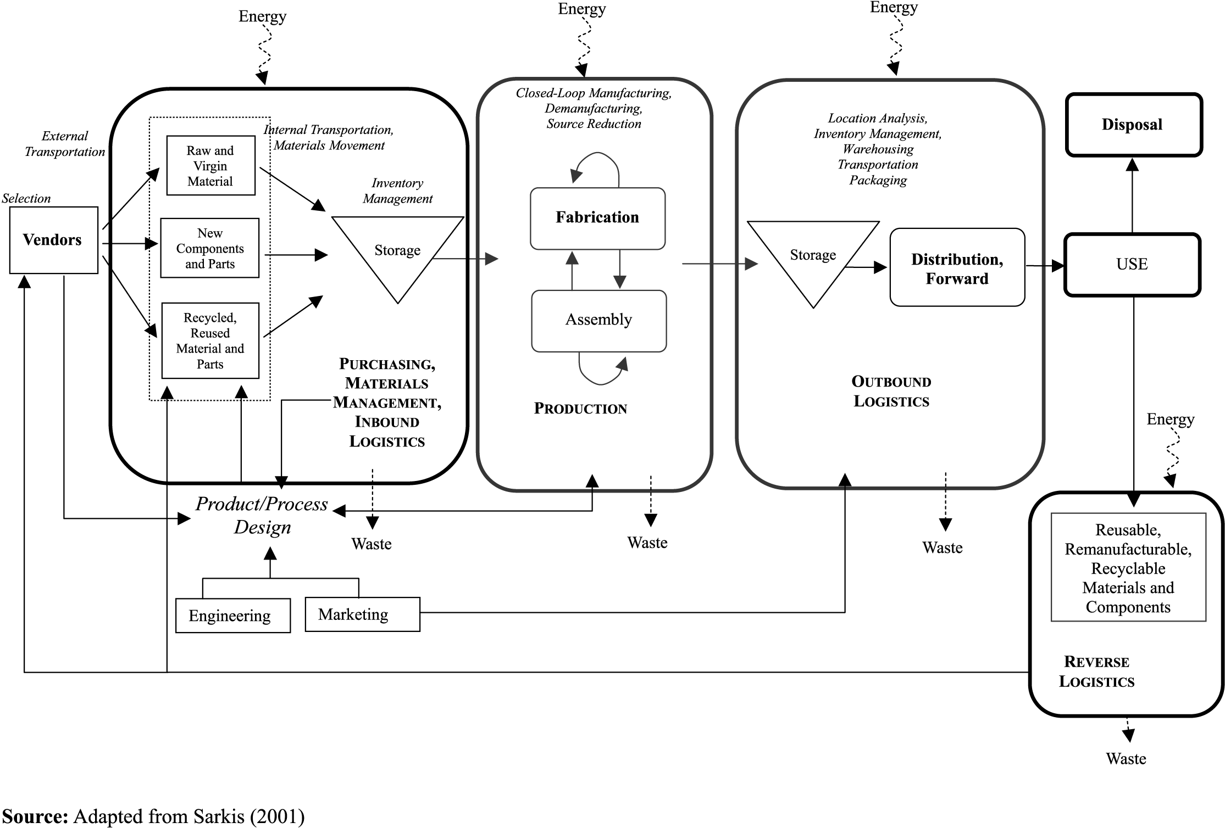
What is logistics?

Slide 37
ABC - analysis
ABC analysis is a categorisation technique often used to keep track of product groups according to their estimated importance. The ABC analysis is based on principles from the Pareto law – “the law of the vital few” or “80/20”.

Slide 38
ABC analysis - an example
A items – 20% of the customers accounts for 60% of the contribution margin.
B items - 40% of the customers accounts for 30% of the contribution margin.
C items - 40% of the customers accounts for 10% of the contribution margin.

Slide 39
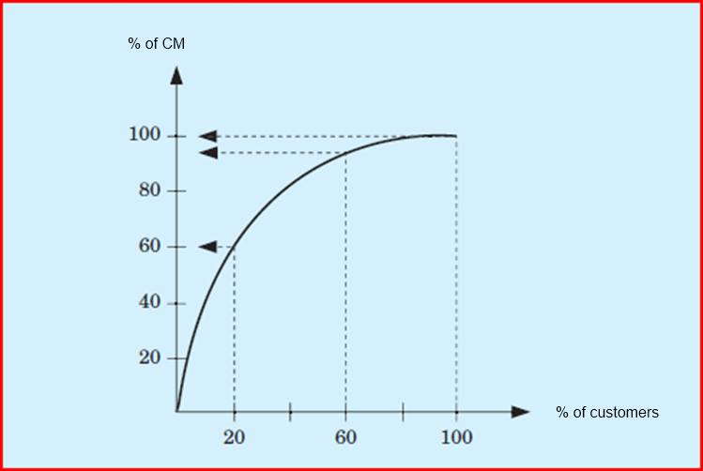
ABC analysis - an example
Which customers do you want to ”nurse”?

Slide 40
Pareto law
Roughly 80% of the effects come from 20% of the causes
Pareto law in software development
20% of software development covers 80% of the requirements
Construction of the last 20% of the functionally takes 80% of the effort
Fixing the top 20% bugs will correct 80% of the errors

Slide 41
Exercise - ABC analysis
Please finish Exercise 1 in logisticsExercise.pdf

Slide 42
Optimal order size
Avoid tying up too much capital in inventory while keeping enough items on stock to optimize customer service by reducing delivery time.
Tree ways of calculation the optimal order size
Using a table
Using a chart
Wilson EOQ (Economic Order Quantity) Model

Slide 43
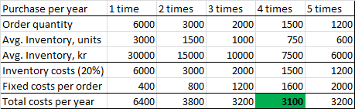
Optimal order size - table
Make calculations based on different order quantities
How precise is this method?

Slide 44
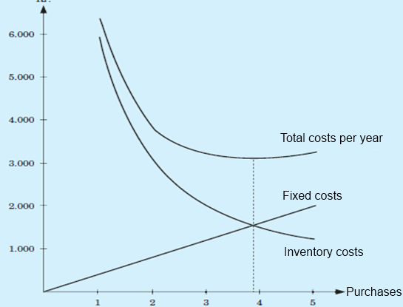
Optimal order size - chart
Find the lowest cost per year
Is this method precise and reliable?

Slide 45
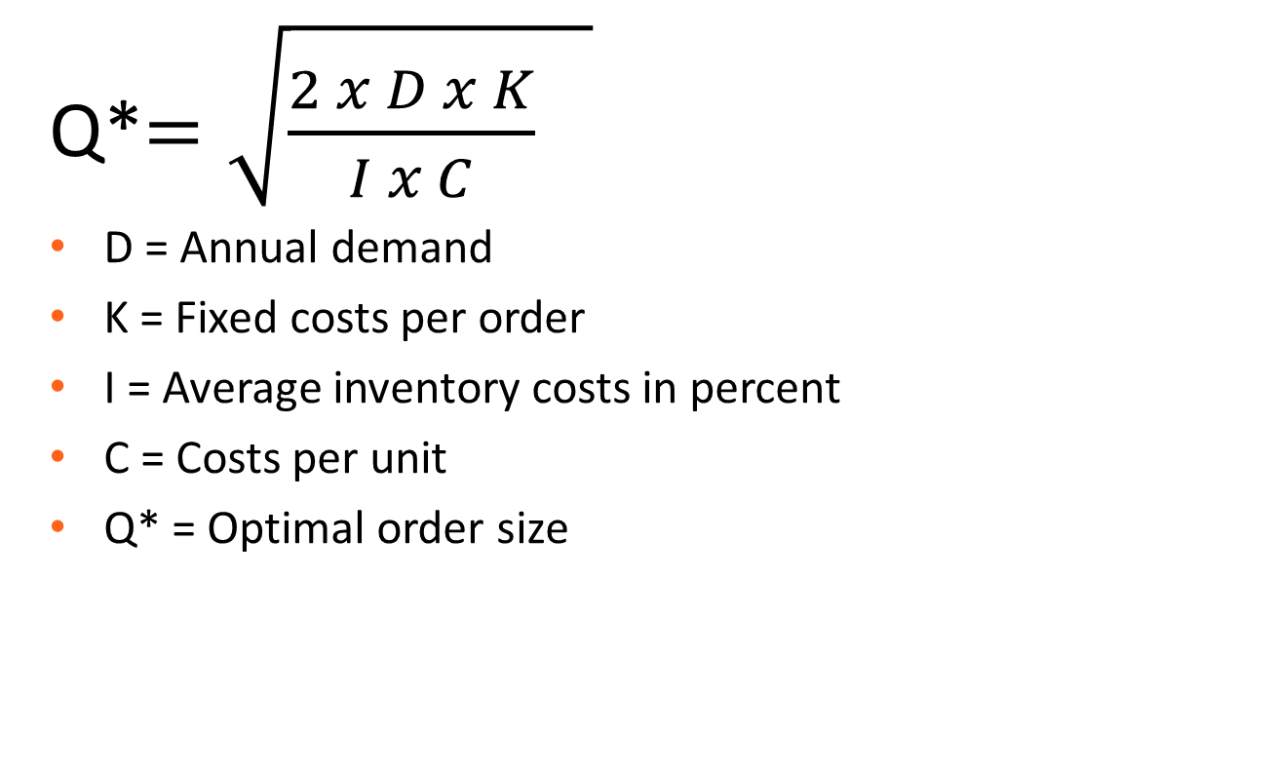
Optimal order size - Wilson
Q*$=\sqrt{{\frac{2 x D x K}{I x C}}^{}}$
D = Annual demand
K = Fixed costs per order
I = Average inventory costs in percent
C = Costs per unit
Q* = Optimal order size

Slide 46
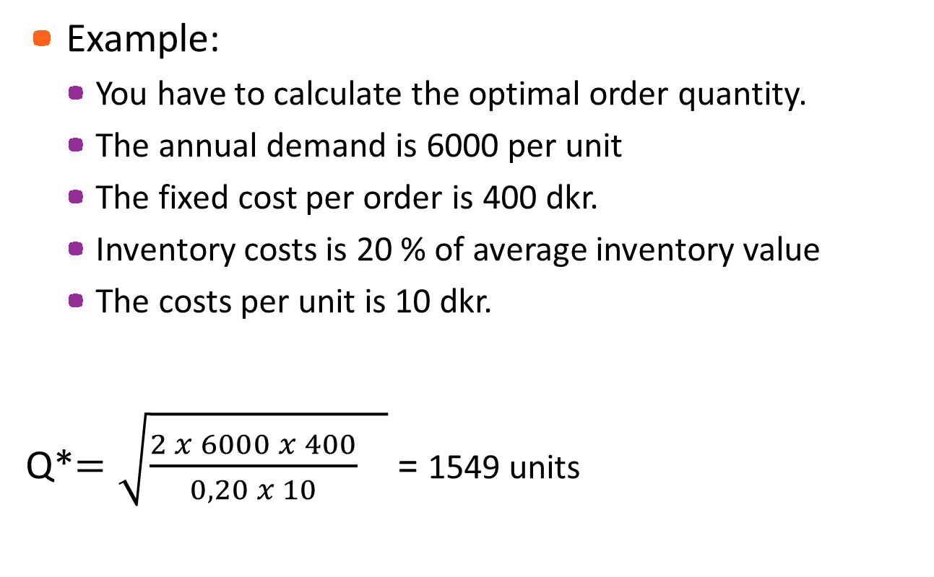
Optimal order size
Example:
You have to calculate the optimal order quantity.
The annual demand is 6000 per unit
The fixed cost per order is 400 dkr.
Inventory costs is 20 % of average inventory value
The costs per unit is 10 dkr.
Q*$=\sqrt{{\frac{2 x 6000 x 400}{0,20 x 10}}^{}}$ = 1549 units

Slide 47
Exercise - optimal order size
Please finish Exercise 2 in logisticsExercise.pdf

Slide 48
Exercise - logistics
Please do the “phidget” assignment (PhidgetAssignment.pdf)
(API manual at http://www.phidgets.com/docs/Language_-_Java#Quick_Downloads )
Please come up with at least two examples on different phidgets and how they can improve the supply chain

Slide 49
Exercise
Write a Java program which can calculate the optimal order size
How to program an ABC analysis?
You might have to break down the task in smaller tasks. Try calculating some key figures from the analysis in a Java program for a start.

Slide 50
Logistics/SCM in 2nd semester project
Consider how you are able to include logistics or SCM in your 2nd semester project.

